Slide 1
Lab 4 Exploring File Commands and Conditional Structure
CSC – 320 Operating System
Engr. Rahemeen Khan
Operating System

Slide 2
File Management Commands

Slide 3
touch Command:
It is used to create a file without any content. The file created using touch command is empty. This command can be used when the user doesn’t have data to store at the time of file creation.
Examples:
$ touch file.txt // Creates a file with extension .txt
$ touch file.txt // Changes the timestamp of the file without changing its contents
$ touch file.sh // Creates a file with extension .sh

Slide 4
cat command:
The cat (“concatenate”) command is intended to join several files named on the command line into one. If you pass just a single file name, the content of that file will be written to standard output. If you do not pass a file name at all, cat reads its standard input. The following examples provide several usage of the cat command.
Examples:
$ cat file1.txt > file2.txt // Copies the content of file1.txt into file2.txt
$ cat file1.txt file2.txt file3.txt > file4.txt // Concatenates in sequence the contents of file1.txt, // file2.txt and file3.txt into file4.txt

Slide 5
read command:
To get input from the keyboard, you use the read command. The read command takes input from the keyboard and assigns it to a variable. The example below provides a demonstration on how to use this command.
Examples:
$ read variable // Takes a value as an input from the user and stores // it in “variable”. Later, you can use$variable to use // the stored value. E.g. $echo $variable

Slide 6
wc command:
Print newline, word, and byte counts for each FILE, and a total line if more than one FILE is specified. With no FILE, or when FILE is -, read standard input. A word is a non-zero-length sequence of characters delimited by white space. The options below may be used to select which counts are printed, always in the following order: newline, word , character, byte, maximum line length.
Syntax:
wc [options] filenames
Options:
wc -l : Prints the number of lines in a file.
wc -w : prints the number of words in a file.
wc -c : Displays the count of bytes in a file.
wc -m : prints the count of characters from a file.
wc -L : prints only the length of the longest line in a file.
Examples:
wc -l tecmint.txt

Slide 7
The > and >> operators:
You can redirect the standard output channel using the shell operator “>”, i.e. (the “greater-than” sign). In the following example, the output of “ls -la” is redirected to a file called "filelist" and not on the screen. If the “filelist” file does not exist, then it is created. Should a file by that name exist, then its content will be overwritten. If you want to append a command’s output to an existing file without replacing its previous content, use the “>>” operator instead. If that file does not exist, it will be created in this case as well.
Examples:
$ ls -la > filelist.txt
$ echo “The End of File” >> filelist.txt

Slide 8
The < operator:
You can use “<” (the “less-than” sign) to redirect the standard input channel. This will read the content of the specified file instead of keyboard input. There is no “<<” redirection operator to concatenate multiple input files.
Examples:
$ wc -w < document.txt // The wc filter command counts the words in file document.txt

Slide 9
Using the redirecting operators together:
The standard input and output may be redirected at the same. In the example below, the word counts output is written to a file called “wordcount.txt”, where -w option is used for obtaining a word count of the input file “document.txt”. A character count can be obtained using the -m option instead of -w.
Examples:
$ wc -w < document.txt > wordcount.txt

Slide 10
Basic arithmetic in Shell Scripts
Arithmetic expansion allows the evaluation of an arithmetic expression and the substitution of the result. The format for arithmetic expansion is:
$(( EXPRESSION ))
Example:
$ echo $((2+2)) // Displays the result 4
Example Code
#!/bin/bash first_num=0 second_num=0 echo "Enter the first number: " read first_num echo "Enter the second number: " read second_num echo "first number + second number = $((first_num + second_num))" // Summation echo "first number - second number = $((first_num - second_num))" // Subtraction echo "first number * second number = $((first_num * second_num))" // Multiplication echo "first number / second number = $((first_num / second_num))" // Division echo "first number % second number = $((first_num % second_num))" // Remainder

Slide 11
Conditional Operator
Operator | Meaning
<=, >=, < and > | comparison operators
== and != | equality and inequality
&& | logical AND
|| | logical OR

Slide 12
Conditional Structures in Shell Scripts

Slide 13
If (The if condition is used for decision making in shell script, where if the given condition is true then the command is executed. The general forms for the if condition that can be used in shell scripting is given below.)
# First form | # Second form | # Third form
if [condition]; then commands fi | if [condition]; then commands else commands fi | if [condition]; then commands elif [condition]; then commands fi

Slide 14
Example Form 1 | Example Form 2 | Example Form 3
#!/bin/bash number=1 if [ $number = "1" ]; then echo "Number equals 1" fi | #!/bin/bash number=0 echo "Enter a number: " read number echo "The number is $number" if [ $((number % 2)) == 0 ]; then echo "Number is even" else echo "Number is odd" fi | #!/bin/bash echo "Enter a number between 1 and 3 inclusive: " read character if [ "$character" = "1" ]; then echo "You entered one." elif[ "$character" = "2" ]; then echo "You entered two." elif[ "$character" = "3" ]; then echo "You entered three." else echo "You did not enter a number between 1 and 3." fi

Slide 15
Arrays in C Language

Slide 16
Arrays a kind of data structure that can store a fixed-size sequential collection of elements of the same type.
An array is used to store a collection of data, but it is often more useful to think of an array as a collection of variables of the same type. Instead of declaring individual variables, such as number0, number1, ..., and number99, you declare one array variable such as numbers and use numbers[0], numbers[1], and ..., numbers[99] to represent individual variables. A specific element in an array is accessed by an index.
To declare a single-dimensional array in C, a programmer specifies the type of the elements and the number of elements required by an array as follows:
Syntax:
type arrayName [ arraySize ];
Example:
Int a [5];

Slide 17
Example Code
#include <stdio.h> int main () { int n[ 10 ]; /* n is an array of 10 integers */ int i,j; /* initialize elements of array n to 0 */ for ( i = 0; i < 10; i++ ) { n[ i ] = i + 100; /* set element at location i to i + 100 */ } /* output each array element's value */ for (j = 0; j < 10; j++ ) { printf("Element[%d] = %d\n", j, n[j] ); } return 0; }

Slide 18
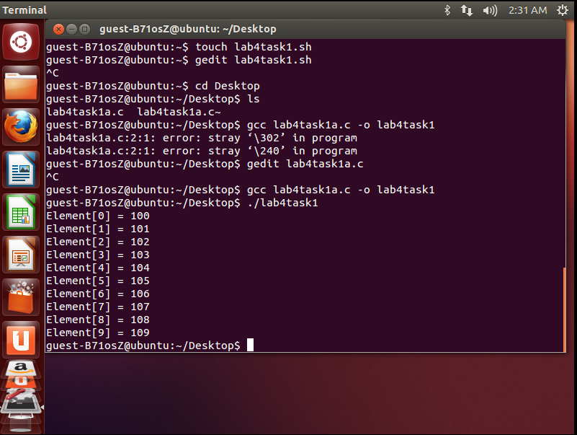
Output

Slide 19
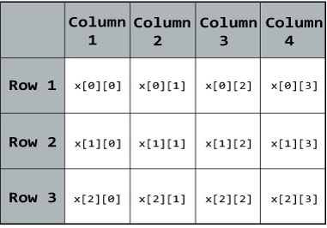
Multidimensional Arrays:
The C programming language supports the concept of multidimensional arrays. The simplest form of the multidimensional array is the two-dimensional array. Here is the general form of a multidimensional array declaration:
Syntax:
type name[size1][size2]...[sizeN];
Example:
float x[3][4];
Note: Here, x is a two-dimensional (2d) array.
The array can hold 12 elements.
You can think the array as table with
3 row and each row has 4 column.

Slide 20
Example Code
#include <stdio.h> int main () { /* an array with 5 rows and 2 columns*/ int a[5][2] = { {0,0}, {1,2}, {2,4}, {3,6},{4,8}}; int i, j; /* output each array element's value */ for ( i = 0; i < 5; i++ ) { for ( j = 0; j < 2; j++ ) { printf("a[%d][%d] = %d\n", i,j, a[i][j] ); } } return 0; }

Slide 21
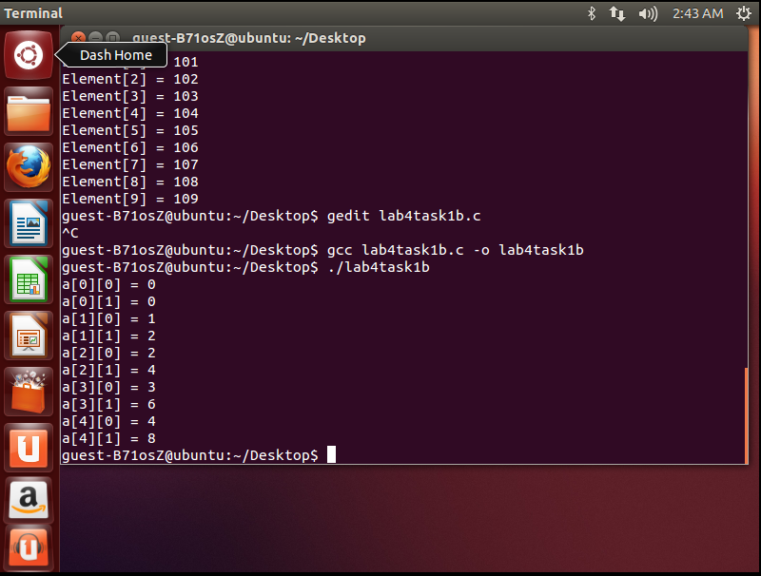
Output

Slide 22
Task 1:
Write a shell script to count all files and folders present in directory and stored the output into a text file and display its content on the terminal.
Task 2:
Write a single shell script that creates four different files, while taking the names of all created files as input from the user. As the files content, insert your name in the first file, registration number in the second and section details in the third. These should be followed by merging the contents of all three files into the fourth one.
Task 3:
Write a shell script that either performs a file sort, file search or directory listing operation based on the user’s selection of the operation he/she would like to execute.
Task 4:
Write a C program that takes values of two matrices of size (𝑚×1) and (1×𝑛) as input from the user. Multiply the above two matrixes and store the resulting (𝑚×𝑛) matrix in a 2D array. Display the contents of the first and second matrices and also the resulting matrix. Achieve alignment in the displayed content as much possible.

Slide 23
Thank You

